Slide 1
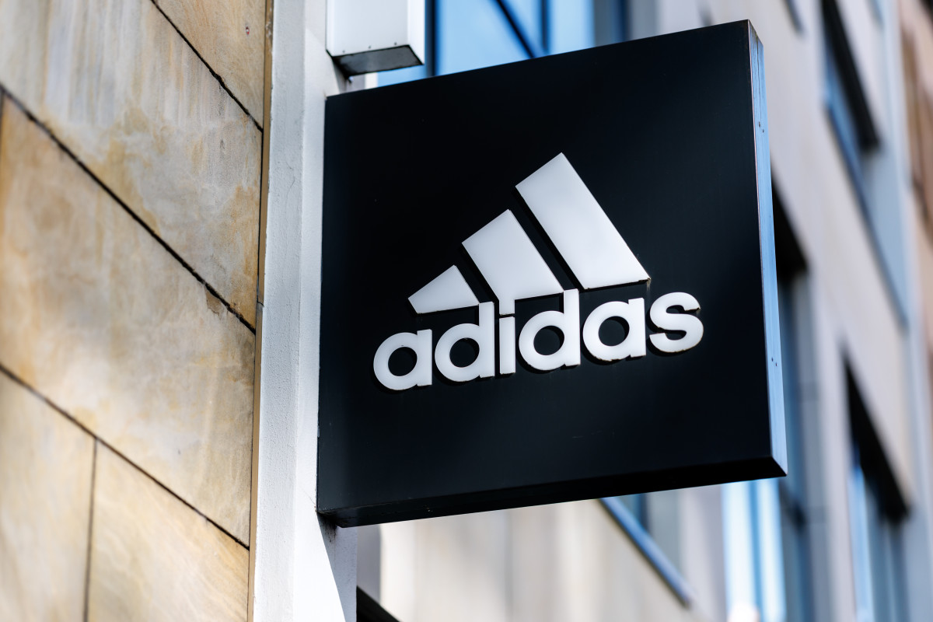
Adidas Sales Data Analysis
BeTechified Capstone Project September Cohort
Presented
BY
Data Analytics Team 3
Date: October 2025

Slide 2
Agenda
Project Objective
Key Business Questions (KBQs)
Dataset Overview
Analysis & Findings (KBQ1–KBQ8)
Recommendations

Slide 3

Dataset Overview
Period covered: 2020–2021 (Quarterly Sales)
Metrics included: Total Sales, Units Sold, Operating Profit, Margin, Sales Method, Region, Retailer, Product Category
Total Sales in dataset = $899,902,125

Slide 4
KBQ1: Top performing Adidas Product
Insight:
Men’s Footwear leads revenue contribution.
Recommendation:
Adidas should maintain footwear as the revenue anchor, while stabilizing apparel sales with better forecasting and seasonal campaigns.

Slide 5
KBQ2: West Region Leads Sales and Profit Growth
Insight:
West region leads with highest sales ($269.9M) and profit ($89.6M).
Northeast is 2nd strongest performer.
Midwest shows lowest profit, needing review.
Recommendation:
Replicate West’s winning strategies (marketing, retail partnerships).
Invest in Midwest with promotions or retail push.
Localize campaigns (e.g., women’s apparel focus in South).

Slide 6
KBQ3: Sales Trend Analysis
Insight:
  Q2/Q3 = strong growth.
  Q4 = decline.
  Apparel fluctuates more than footwear.
Recommendation:
  Launch holiday & winter campaigns in Q4.
  Improve apparel design + inventory management to reduce volatility.

Slide 7
KBQ4: Top performing Retail Partners
Insight:
  Foot Locker ~177M benchmark.
  West Gear and Sports Direct strong.
  Walmart lagging.
Recommendation:
  Strengthen Walmart partnership (exclusive lines, bundles).
  Deepen partnerships with Foot Locker & West Gear (exclusive drops).
  Use Amazon for steady, long-term growth.

Slide 8
KBQ5: Sales channel with most unit sold
Insight:
  In-store sales still higher, but online sales grew post-2020.
Recommendation:
  Double down on e-commerce investments.
  Build omnichannel strategy (buy online, pick up in-store).
  Leverage data from online buyers for targeted campaigns.

Slide 9
KBQ6: Growth trends by category
Insight:
    Q2, Q3 shows positive growth across most categories .
    Q4 shows decline across all categories.
Recommendation :
    Boost Q2/Q3 with campaigns & stock readiness.
    Counter Q4 dip with holiday promotions.
    Improve forecasting to stabilize apparel.

Slide 10
KBQ7: Retail Performance vs Benchmark
Insight:
Foot Locker sets the benchmark at ~$177M.
Sports Direct and West Gear performed close to benchmark
Walmart lags significantly, needing strategic focus.
Recommendation:
Use KPIs from top performers as a playbook for weaker markets (e.g., pricing, promotions, assortments).

Slide 11
KBQ8: Product performance across regions
Insight:
  Men's street footwear sells most across the Regions except for South where Women's Apparel sells most.
  Women's Athletic footwear sells least across all the Regions
  There is moderate sales in Women's Apparel across the Regions accept in south, where there was higher sales as compared to the other products.
Recommendations
  Focus on Men’s Street Footwear to maximize revenue.
  Boost Women’s Apparel sales with targeted campaigns.
  Improve Women’s Athletic Footwear through redesign & promotion.

Slide 12
Conclusion & Recommendations
Product Strategy
Keep men’s footwear as core revenue driver.
Revamp women’s athletic footwear line (collabs, influencer marketing).
Stabilize apparel with trend-based & seasonal collections.
Channel Optimization
Strengthen e-commerce (mobile-first, loyalty programs).
Integrate omnichannel (online orders + in-store pickup).
Maintain in-store experience for flagship launches.
Regional Focus
Replicate West region’s strategies in Midwest.
Push women’s apparel in South (local demand).
Tailored promotions for Northeast & Midwest to boost profit margins.
Retailer & Partner Management
Deepen Foot Locker + West Gear partnerships.
Fix Walmart underperformance with exclusive lines.
Expand steady growth on Amazon.
Demand Forecasting
Prepare for Q3 spikes (stock footwear).
Address Q4 decline with holiday campaigns.
Invest in predictive analytics to align inventory with seasonal demand.

Slide 13
Any Question ?

